Slide 1
Smart Rods (Hardware)
Mattin Mir-Tahmasebi
Supervisor: Prof. Constantinides
Notes:
Going to talk about:
My name is Mattin, my project was to improve educational tools used in primary school mathematics classrooms
Going to explain what is currently wrong and how we aimed to improve upon it, talk about different possible designs, what went well (and not so well) during the process, and will hopefully end with a video demonstration of the product made. Worked in partnership with Pierre who produced a web app and took care of data processing, whereas I took care of the hardware.

Slide 2
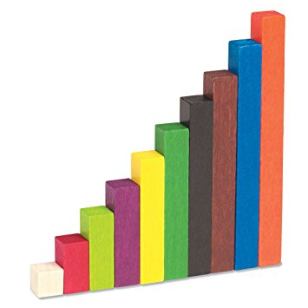

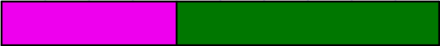
Cuisenaire rOds
2 + 8 = 10
4 + 6 = 10
Notes:
The tools we are focussing on are Cuisenaire rods.Tools used to help children learn number bonds. These are sets of sums that all add to a particular number, like 10. Like the examples shown here.
Are not associated with numerals so can extend to other units eg. Decimals. Concepts before notation.

Slide 3
Project Aims
Record and track student progress
Save time currently wasted on administration
Notes:
Problems with the rods that the project tries to solve:
- Difficult to keep track of the entire class, knowing who is struggling/excelling. The product should record work and discern this information
Teachers have to record proof of their students’ work – since the rods do not involve any writing, there is no proof, so at the end of the lesson, the children have to write what they did. This wasted time could be spent learning.

Slide 4
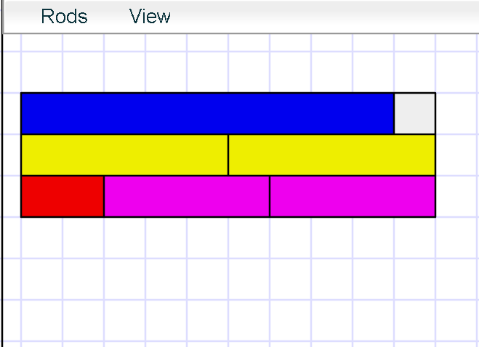
Existing products
Virtual Cuisenaire Rod Environments
Notes:
No similar existing products – no precedent means higher chance of failure when trying new ideas
Most existing products were software tools - research shows manipulatives help connect exercises to real world problems
One relatively similar product: osmo. Uses physical objects read by camera into app, but in our product we want the focus to be the rods not a screen.

Slide 5

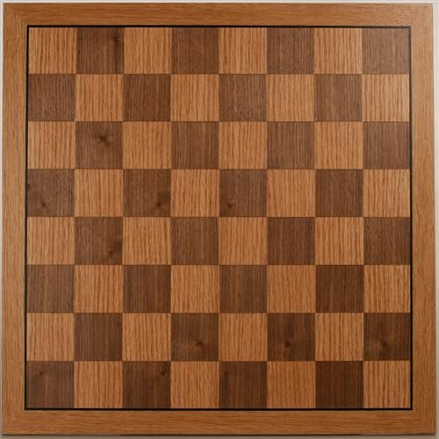
Where should the electronics go?
In the rods?
Too small
Power-hungry
Expensive
Many units to charge
Easily misplaced
In a playing board
Can contain all circuitry
Fits a large battery
Cheaper
One unit to charge
Hard to lose

Slide 6

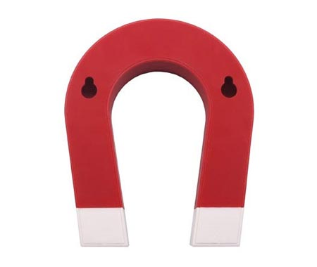
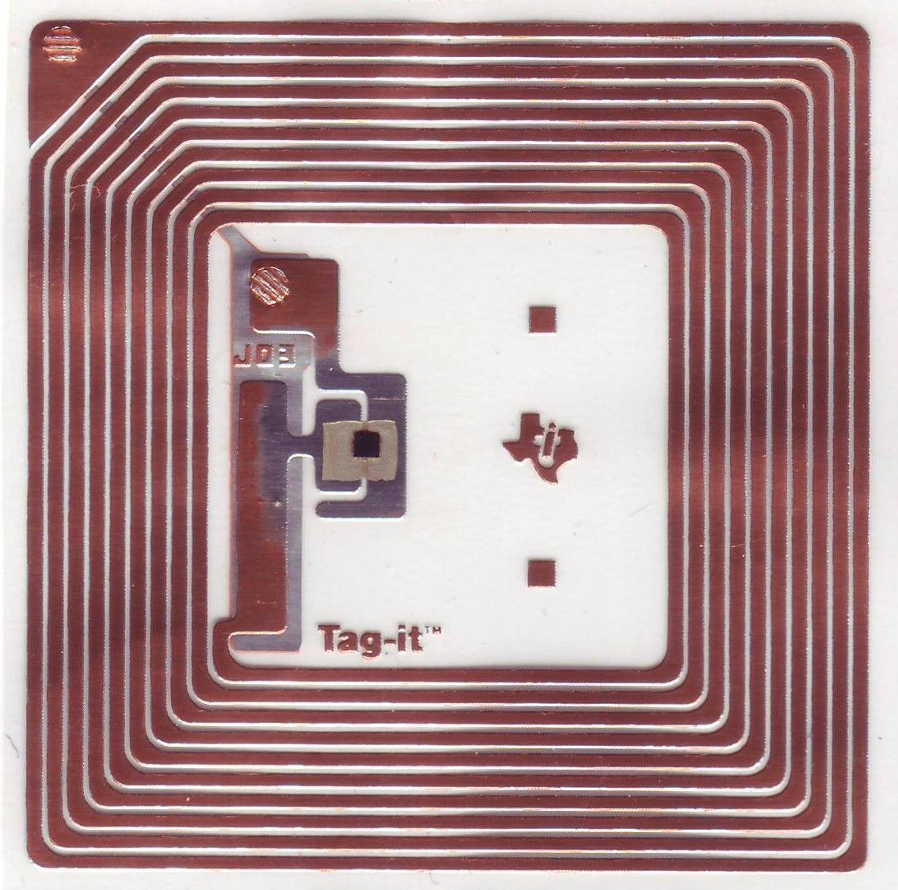
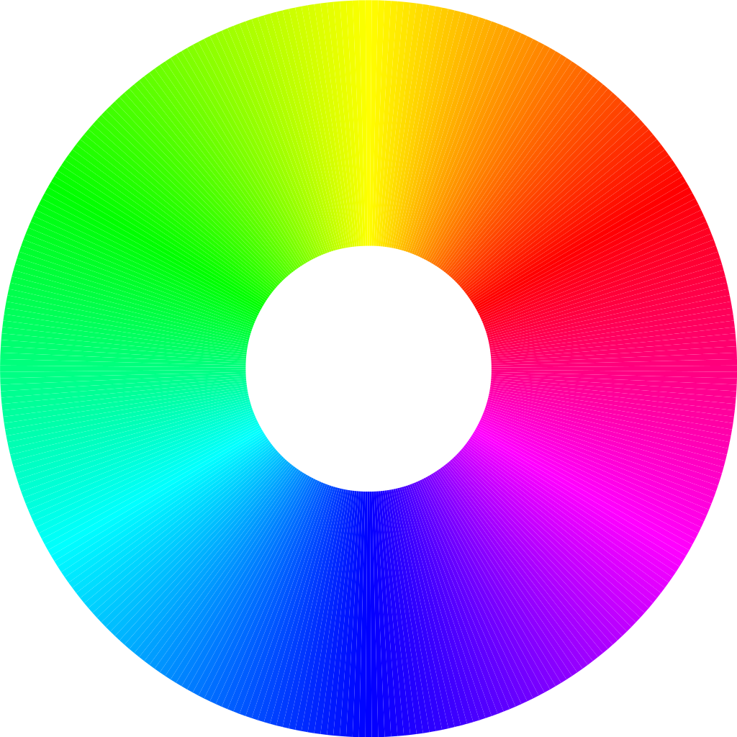
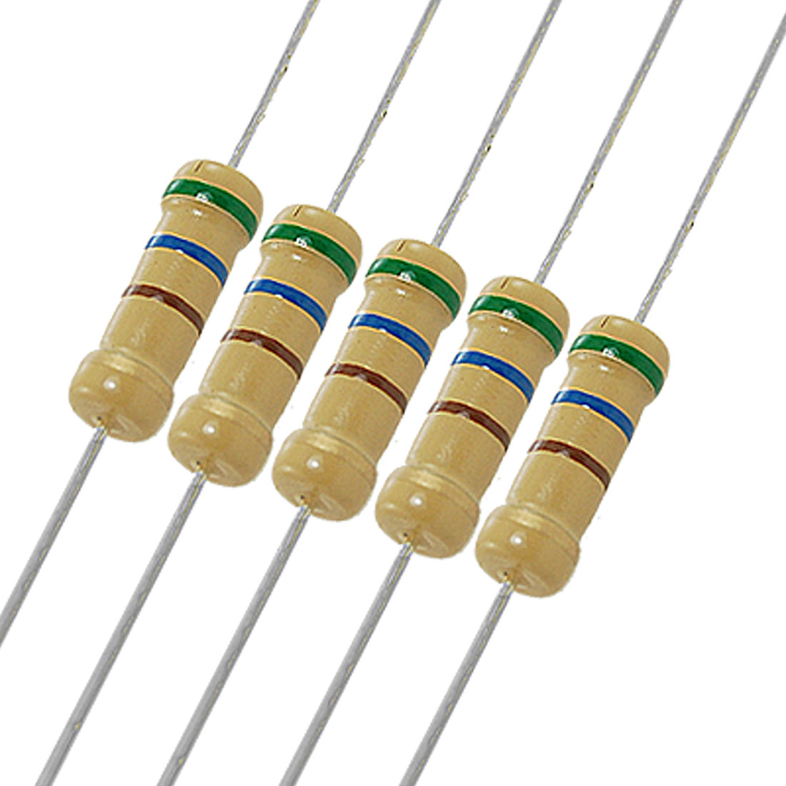
How to detect rod positions
 | Weight | Magnetic Fields | RFID | RGB Light | Resistor Chains
Reliability
Cost
Power Usage
Rod Complexity
Notes:
Important criteria were…
Weighted rods, weight sensors on board
Magnets in rods, hall-effect sensors in board
Passive RFID chip in rods, rfid readers in board
Different coloured rods, RGB sensors in board
Conductive material in rod, to short out chains of resistors in board
Resistors were the best.

Slide 7
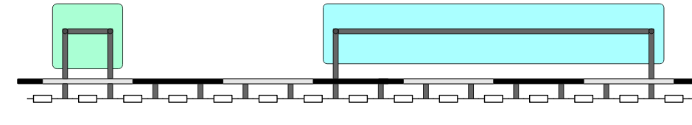
Shorting Resistor Chains
5.0V
4.4V
4.4V
3.6V
2.9V
2.1V
1.4V
0.7V
0.7V
0.7V
0.7V
0.7V
0.7V
0.7V
0.7V
0V
Notes:
Software works by sweeping through the chain reading the voltage at every node, and noting where there are consecutive nodes with the same voltage. The number of consecutive equal voltages is proportional to the size of the rod.

Slide 8
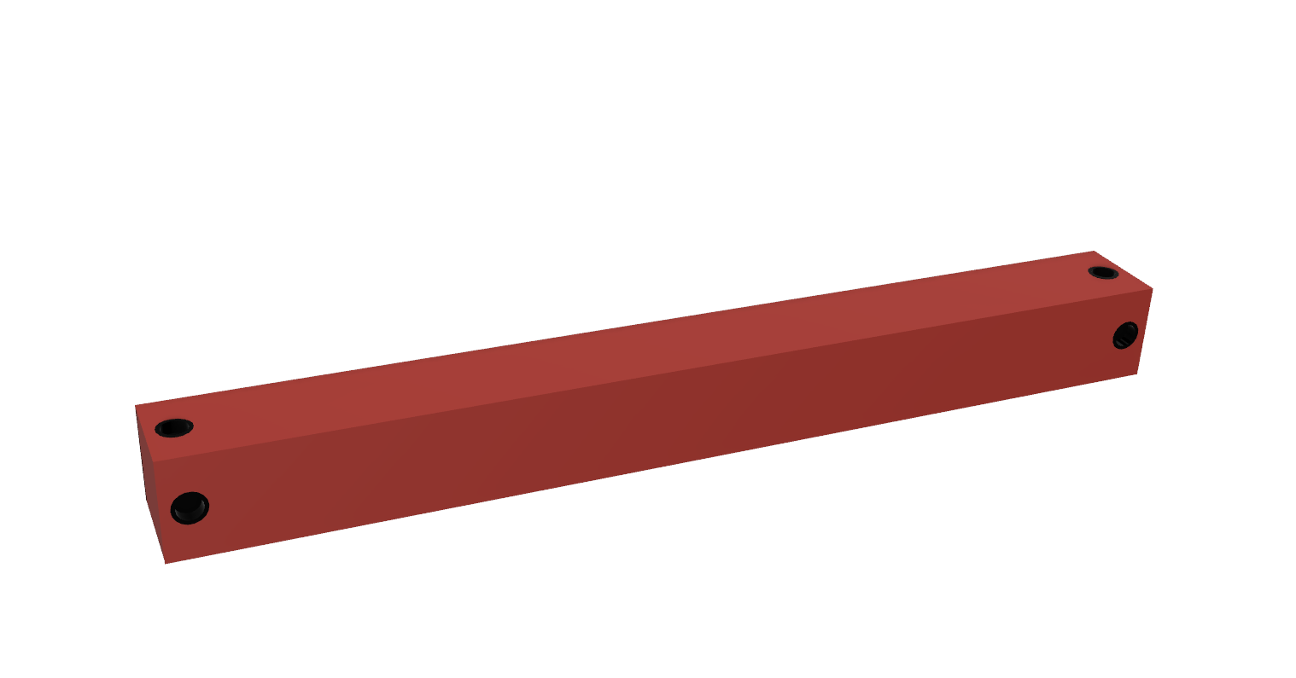
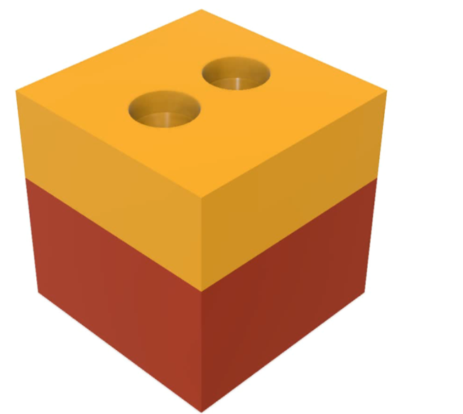
Inside the rods
Conductive 3D-printed material
Wire embedded in rod creates short circuit
Notes:
First idea was to print the rod with conductive material inside. Black contact points on the ends show where the conductive material would be exposed
However, the resistance was 1Kohm, so for it to act as a short circuit, the resistors in the board would need to be >1MegaOhm, which reduced the current too low for the multiplexers to take a reading.
Switched to method of passing a wire inside the rod since that won’t have the resistance problem.
Less elegant but functional.

Slide 9
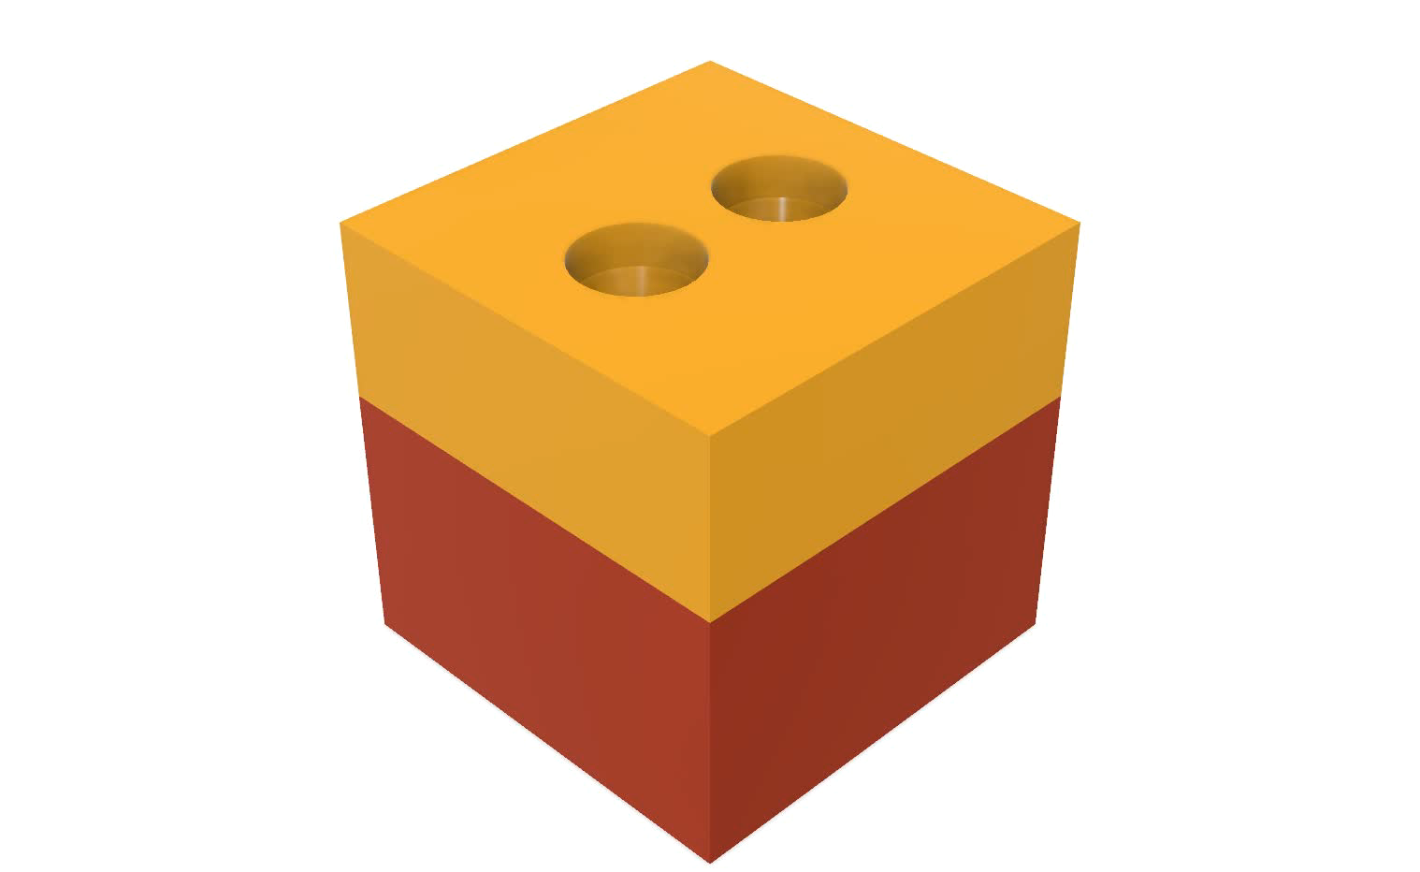
Notes:
The rod is made of two separate parts that are glued together

Slide 10
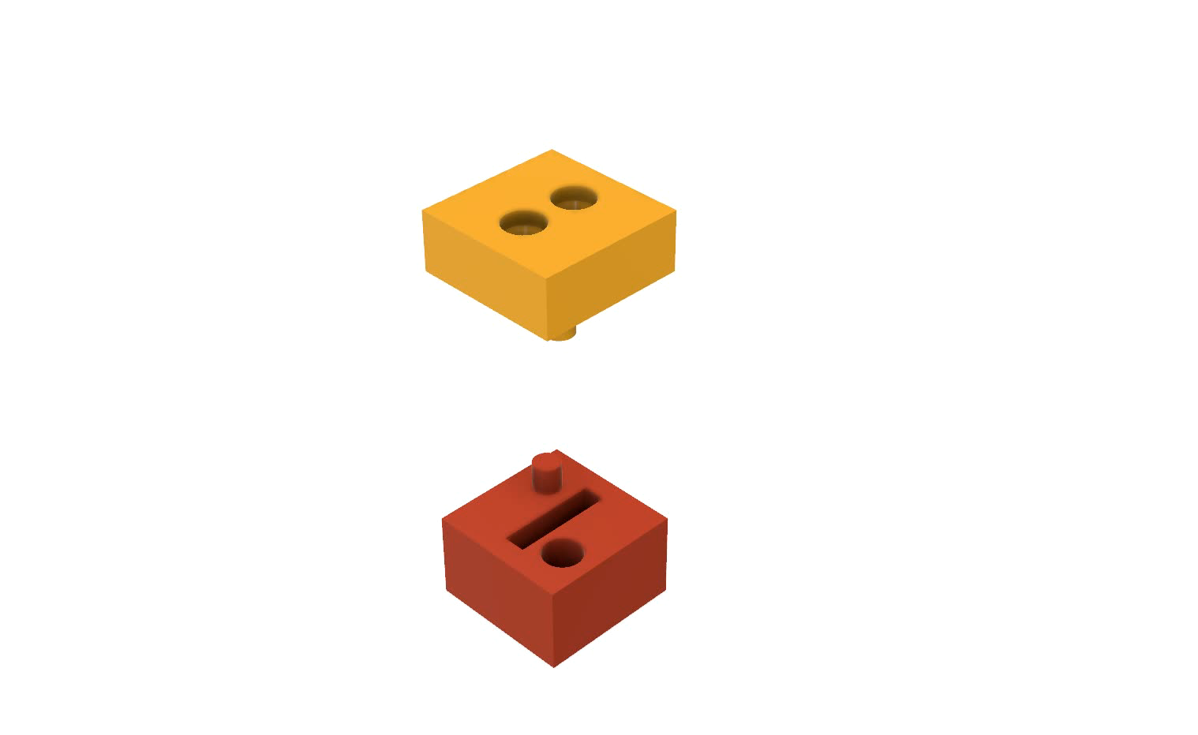
Notes:
The bottom half is where the body of a wire would sit. The hole and protrusion in the corners is used to glue this half to the other half

Slide 11
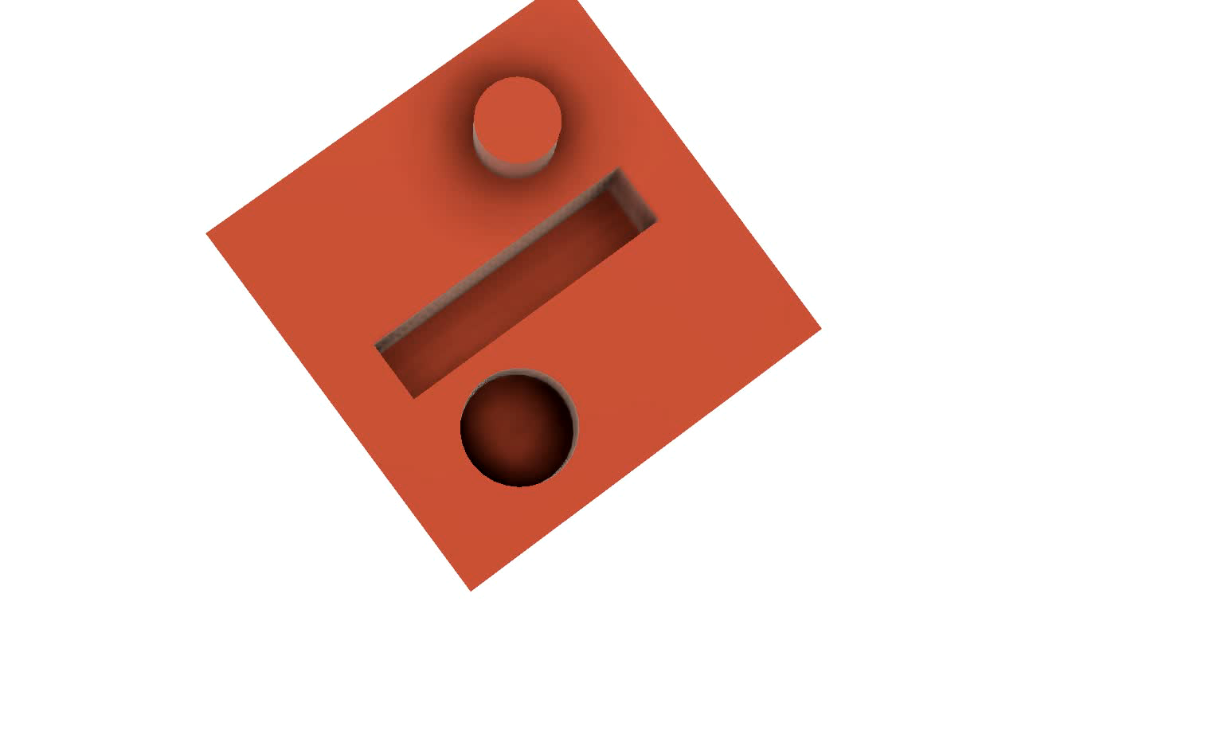
Notes:
The underside of the top half has two small holes where the stripped ends of the wire would pass through. You can also see it has a hole and protrusion to glue the pieces together, like the bottom half.

Slide 12
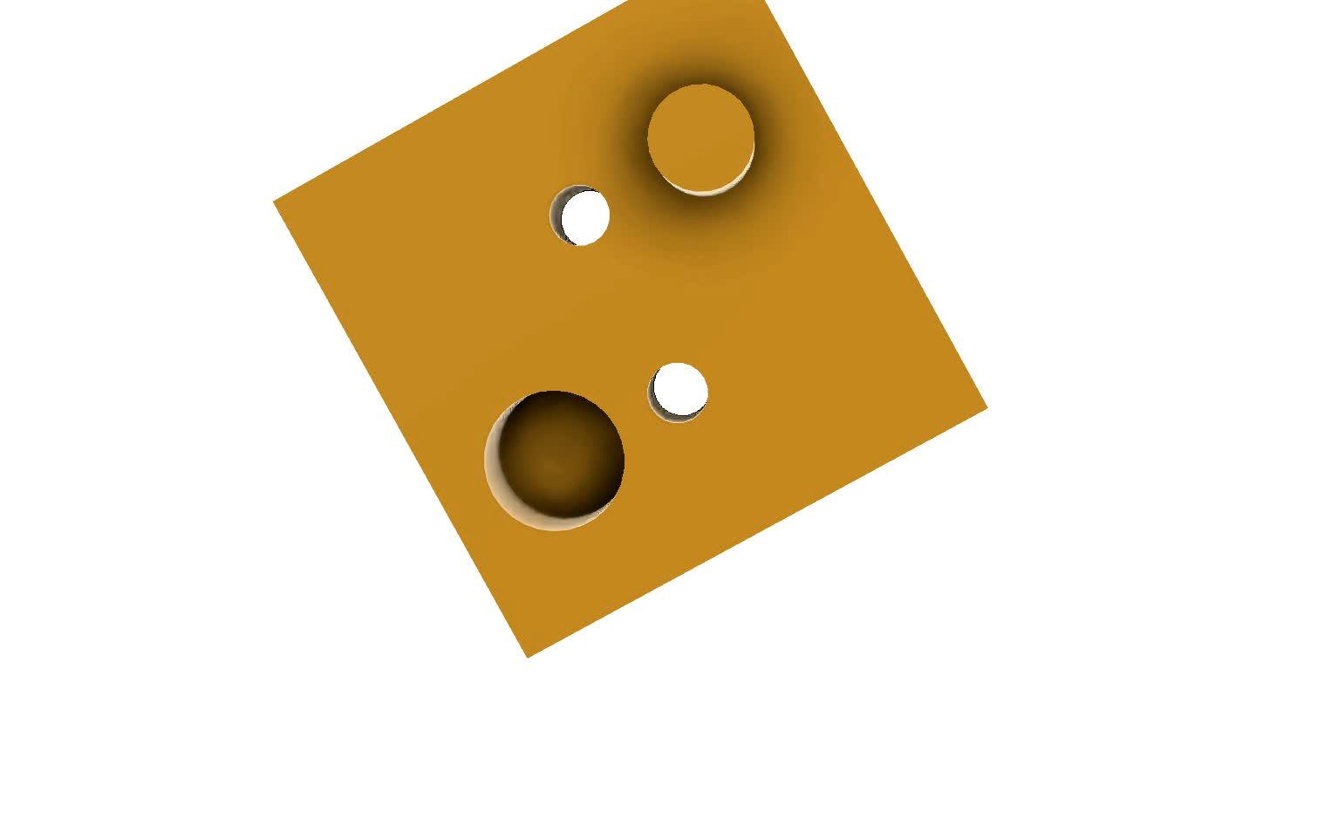
Notes:
The top half has larger holes to fit the contacts which would be connected to the ends of the wire inside the rod.

Slide 13
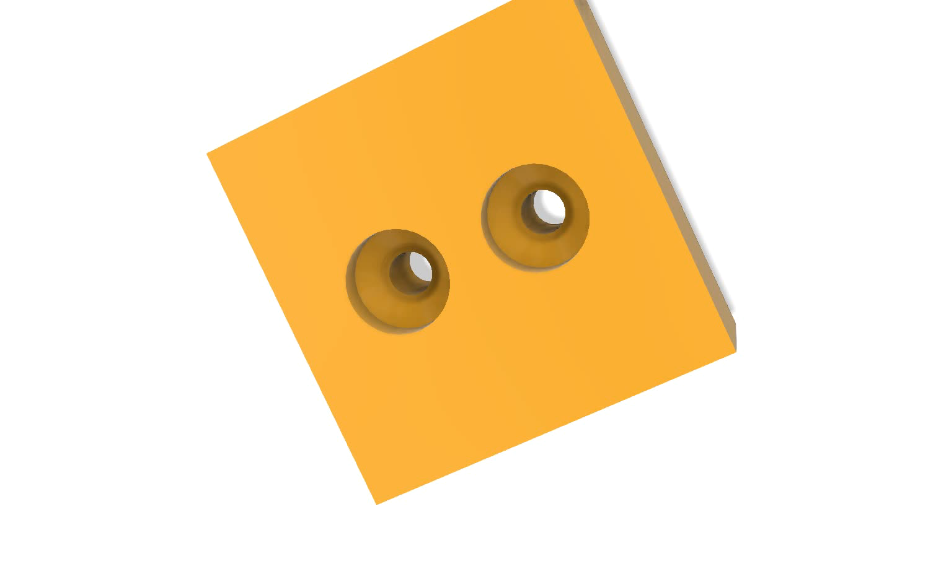
Notes:
So after the rod has been inserted the two pieces are glued together.

Slide 14
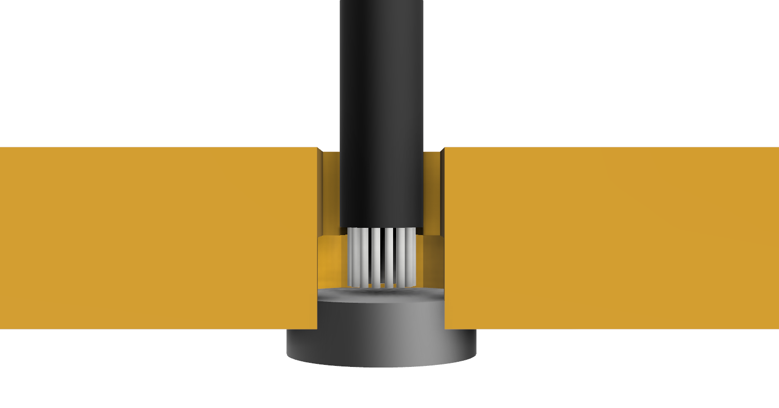
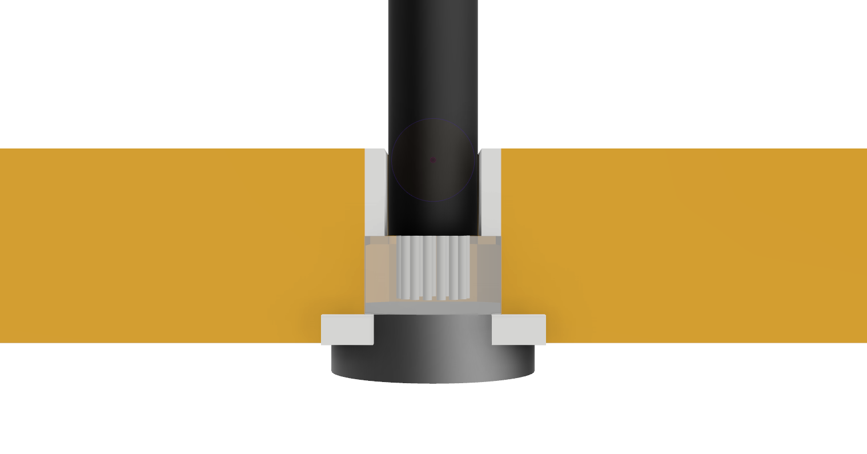
Magnetic Electrical Contact
Extreme heat demagnetises magnets. Alternatives:
Silver Paint – Conductive, but not adhesive
Conductive Epoxy – Difficult to apply
Notes:
Can’t Solder magnets because the heat passes the curie point, where it becomes demagnetised, so need a non solder solution.
Silver paint – good conductor, bad adhesive.
Conductive epoxy – good conductor and adhesive, difficult to apply to small space
Use silver paint to fill cavity as a conductor, use normal glue as adhesive.
Other ideas: wrap magnet in foil – could wear away easily,

Slide 15
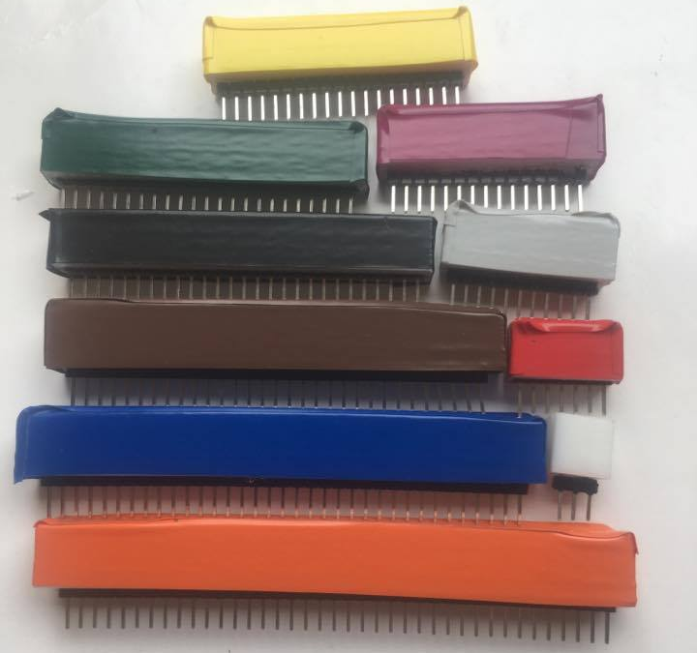
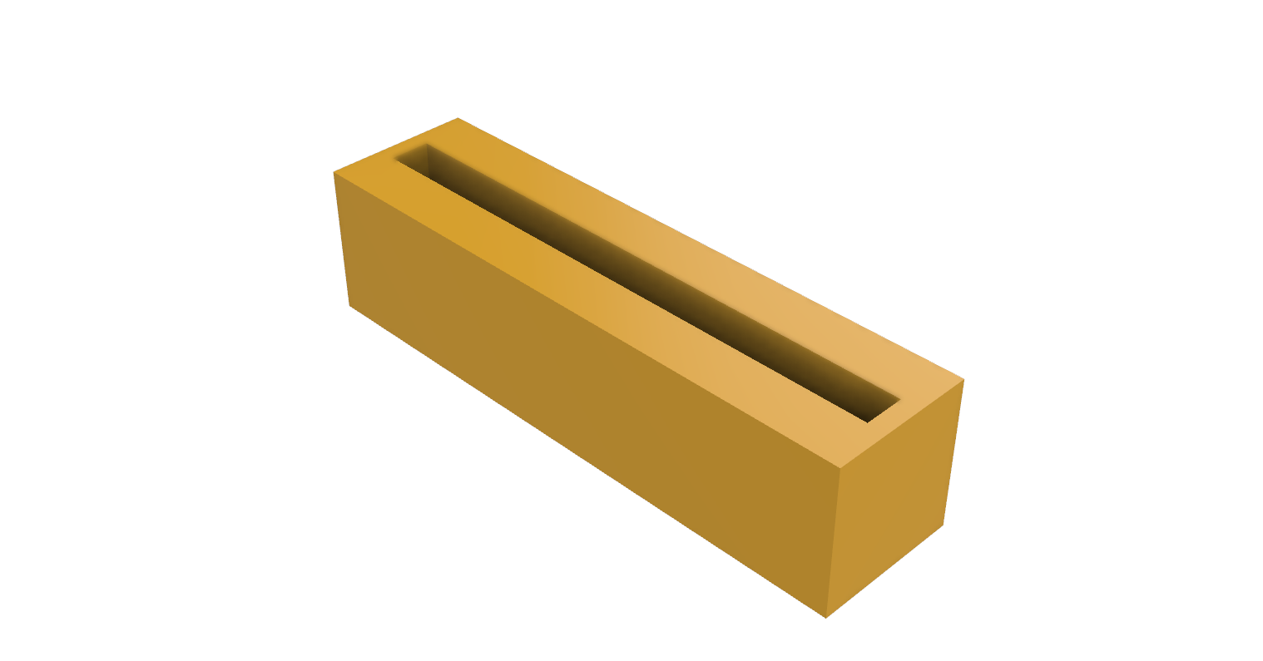
Header Pin rods
Rod with space for header pins
Produced all sizes of rod
Notes:
Created as last resort in order to demonstrate proof of concept. Male headers are soldered together at the ends, and glued into the rod. Female headers on the board they are placed into.

Slide 16

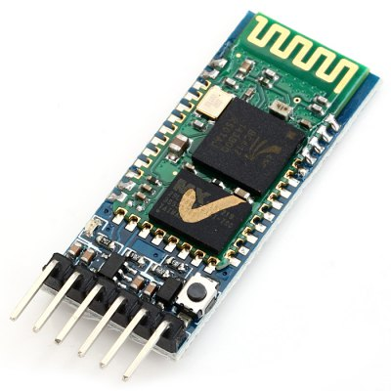
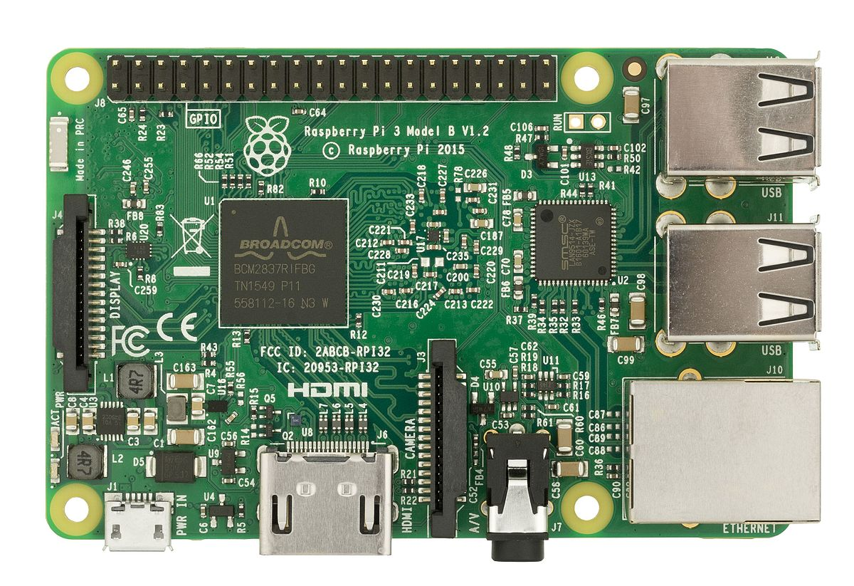
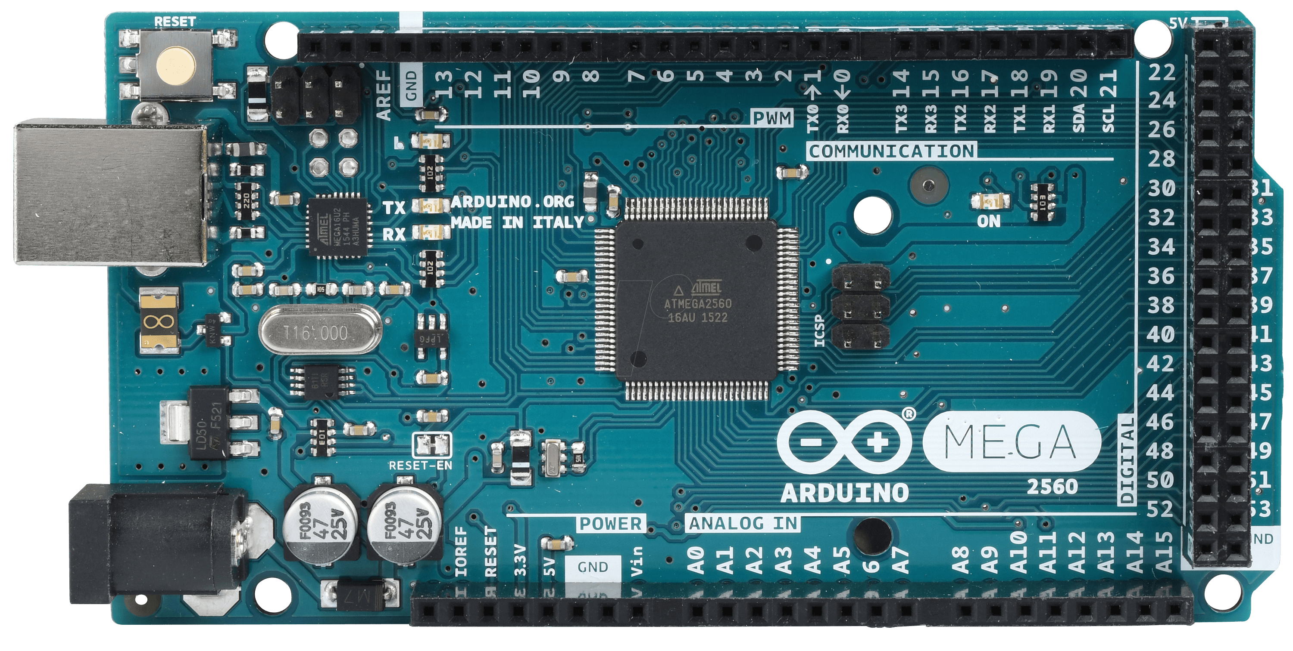
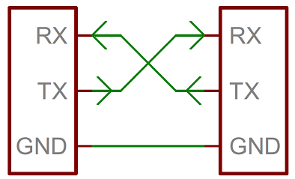
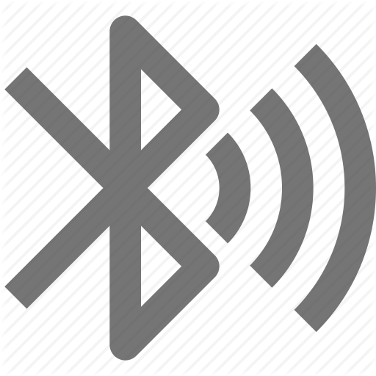
Communication
app.smartrods.co.uk
Arduino Controller
HC05 Bluetooth Module
Raspberry Pi Hub

Slide 17
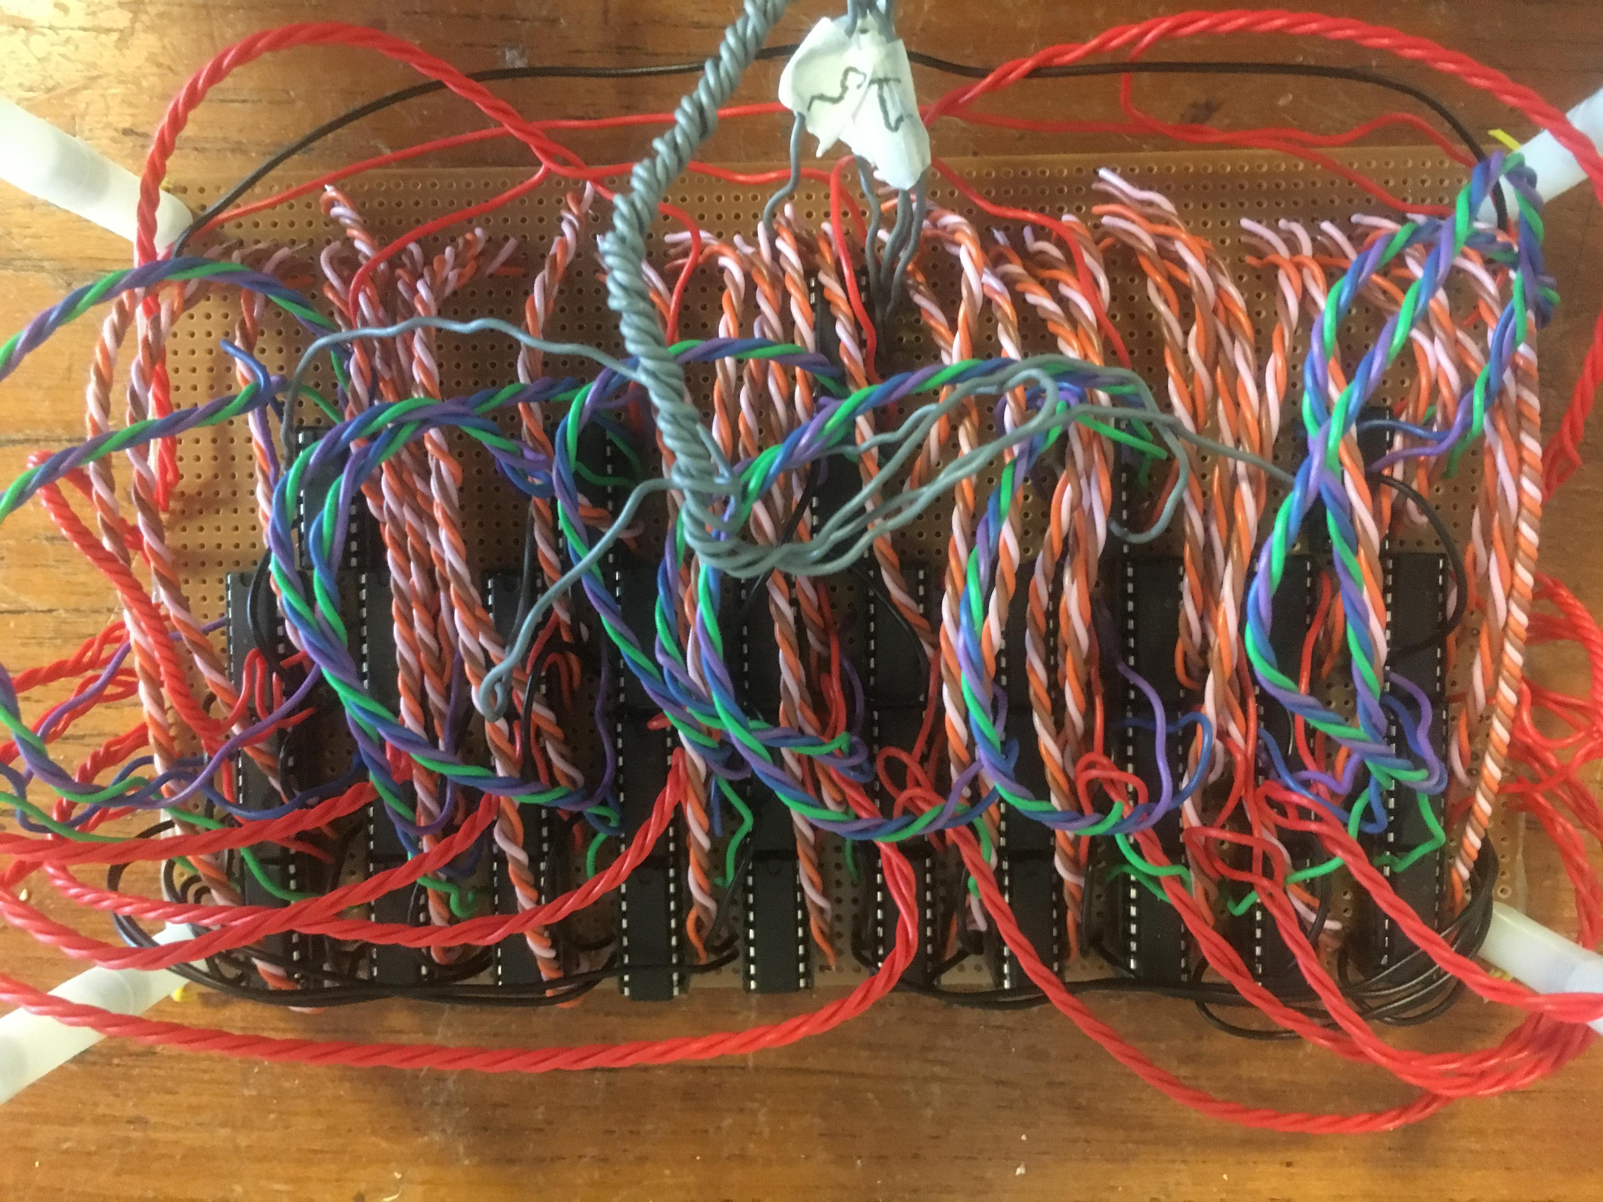
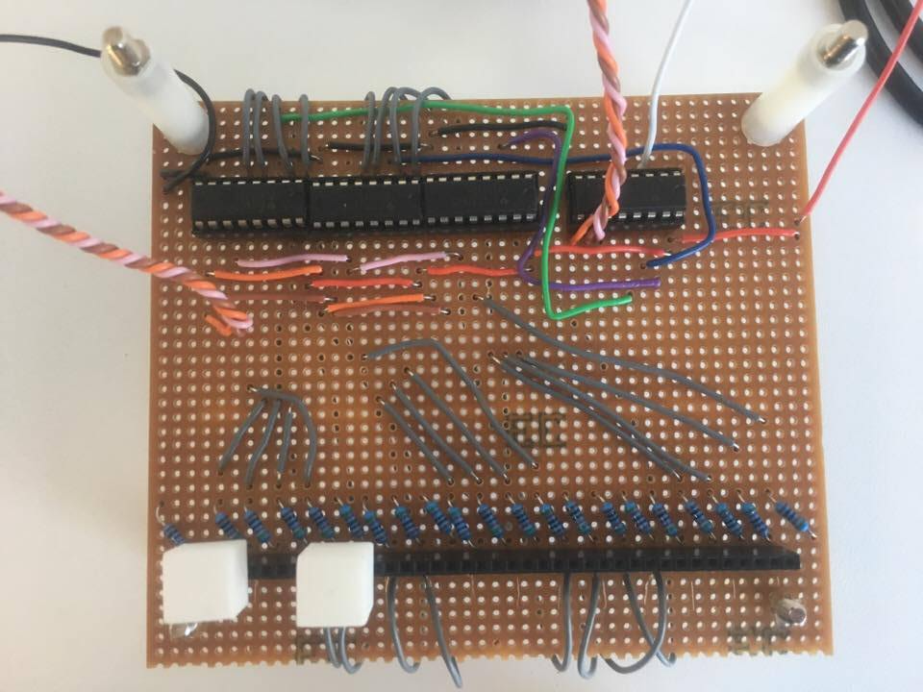
Deviations from design
Full-sized circuit became too complex
Produced one row of the board instead
Notes:
Originally was decided to create the circuit on stripboard for flexibility, but found the circuit to be more complex than first considered. Took two weeks to get halfway, decided to make one row instead as a proof of concept.

Slide 18
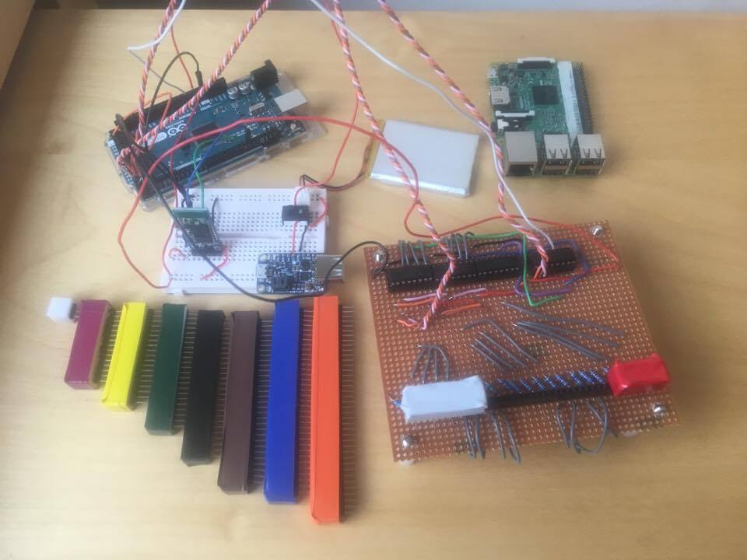
Final Product
Product consists of:
Board
Enhanced Rods
Arduino Controller
Raspberry Pi hub
Bluetooth module
Battery
Power Converter
Notes:
Case was not made due to time constraints but was designed.

Slide 19
Testing
Product detects rods reliably
Rods are durable and withstand breaking

Slide 20
Conclusuions
Pros
Cons
Reliably records students’ work
Removes need for writing solutions
Final product does not match intended design

Slide 21
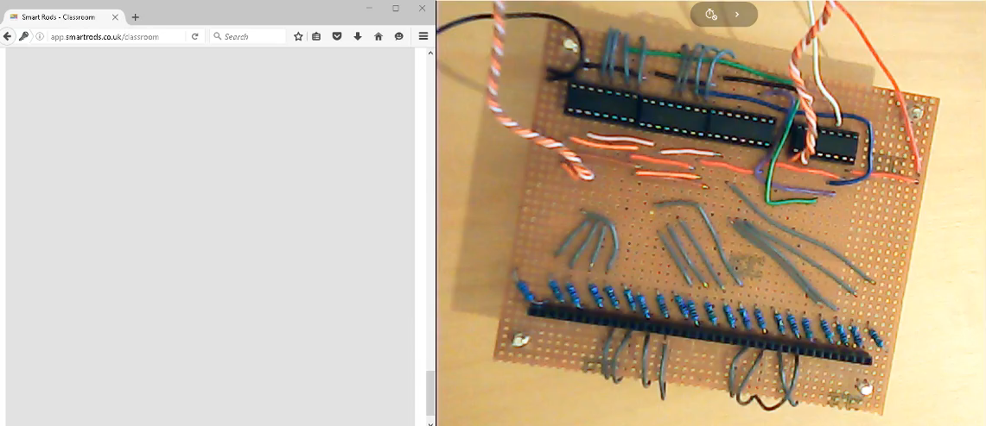
Video Demonstration

Slide 22
Image Sources
Slide 2: Rods – Amazon.co.uk
Slide 4: Osmo – PlayOsmo.com
Slide 5: Chess board – ChessHouse.com
Slide 16: Arduino – Arduino.cc, HC05 - , Rpi – Wikipedia, Bluetooth – iconfinder.com

